Slide 1
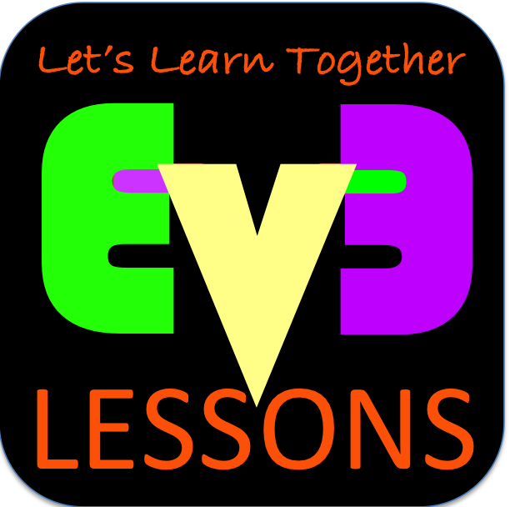
Improving Robot Reliability
Written in response to questions from another FLL Team

Slide 2
Sources of Problems
Problem | Impact
Alignment in base varies from run to run | Each run is different and missions sometimes work.
Robots don’t travel straight for long or turn exactly the same amount | It is hard to predict the robot location exactly.
Errors accumulate as you travel | Long missions tend to fail. It is hard to do missions far from base
Adjusting motors/attachments in base | First move out of base may behave differently each time. Attachments don’t work the same each time
Battery levels impact motor performance | Tweaks that work today fail tomorrow

Slide 3
Starting Points in Base are Critical
FLL teams need to figure out where to start in base
  Jigs: a LEGO ruler/wall that your robot can align against them in base
  Same start each time: pick one spot and start there no matter what the mission for easy starts
  Inch marks: Use the inch marks to pick a starting spot for each run
  Words: Base has words. If you aren’t near an inch mark, pick a word or letter to start on.
Even better, try to find a way to align the robot using other techniques (see next page)
Use a jig
Use marks

Slide 4
Robot Doesn’t Travel Straight & Errors Accumulate Over Time
By the time you get to the far side of the table, you are no longer in the right position
Solution: Repeat alignment techniques multiple times in a run for better reliability (see next slide)
Mission Model 1
Mission Model 2

Slide 5
Where are you on the FLL table?
Consider these alignment strategies that are commonly used:
  Align on walls – deliberately back into a wall to straighten out (note: You may stall doing this. See the Stall Detection Lesson)
  Square/Align on lines –If you are moving angled, you can straighten out whenever you see a line. (See Squaring Lesson)
  Move until a line – travel until you find a line so you know where you are on the mat (See Basic Lessons)
  Align on a mission model – Mission models that are stuck in one place can be used to align against
Back into walls
Square on a line
Align on a mission model
Mission Model

Slide 6
Adjusting Attachments in Base
Just like the robot body, you need to set up your attachments in the same way each time for improving reliability
  Jigs that allow the attachment arm to only move to a certain level to make sure the arm is set the same way each time
    In Senior Solutions, we used a jig to make sure the arm that picked up the pill box always started at the right level
  Indicators on the robot (e.g. bright peg) might help you remember where to reset the arm to
    In Food Factor, we had a red peg in a hole to remember how far back to move the arm
  You can use a touch sensor to detect the position of an attachment at the start of a run

Slide 7
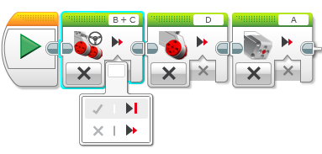
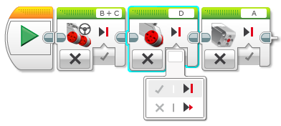
Adjusting Motors in Base
Moving attachments or wheels
  When the program is stopped you can move wheels and attachments easily and it has no impact
  If a program is running, there are multiple steps
    You need to put the motors into “coast” mode
    If you move the motors in coast mode, the motors will move back to the original position on the first move!
      You need to “reset” the motor after an adjustment and before you start your run
1) Put all the motors you use on coast so you can move the motors by hand to adjust
2) Now you have to “reset” the motors

Slide 8
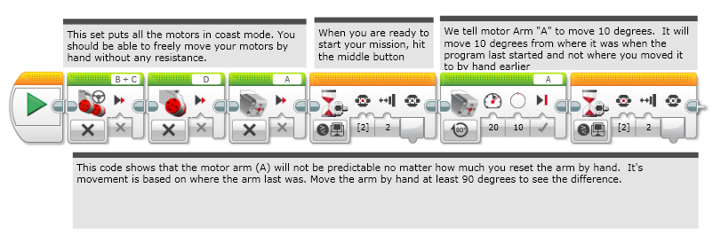
Using Coast
Doesn’t work well. Not as reliable!

Slide 9
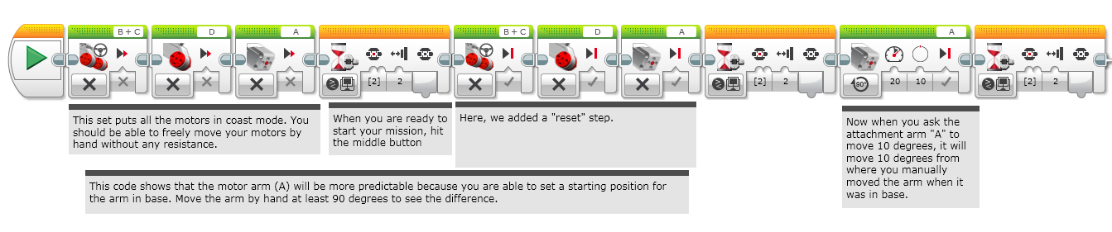
Using Coast & Reset
More reliable!

Slide 10
Other Factors in Reliability
Battery life
  If you program your robot when the battery life is low, it won’t run the same when fully charged
    Motors behave differently with low battery
    But using sensors makes you not as dependent on battery
LEGO pieces come apart over time:
  Squeeze in LEGO pieces in key areas before a run – the pegs get loose which means the sensors may not be in the same place as a previous run
  Push wires in for sensors and motors. They come out!
Motors and sensors don’t always match:
  Some teams test motors, sensors and wheels to make sure that they match
  You will never get a perfect match so we recommend use other techniques and accept that they will be different

Slide 11
Credits
This lesson was written by Arvind Seshan and Sanjay Seshan from FLL Team Not the Droids You Are Looking For
These lessons are free to use and adapt. Just give credit to the original authors of the lesson
More lessons at: www.ev3lessons.com

