Slide 1

INTERMEDIATE programming LESSON:
MOVE INCHES MY BLOCK
By Droids Robotics

Slide 2
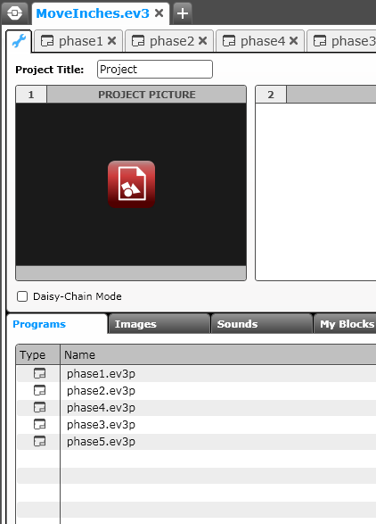
My blocks with inputs and outputs (Move InChes)
See the corresponding EV3 Files for step-by-step instructions and the actual code for you to learn how to make a Move Inches My Block. The code has been made in steps (phases).
Start at the Phase 1 tab and read all the comments in each one. We also give all the code so you can follow along and try it out.
The next few slides are screen captures of the lesson.

Slide 3
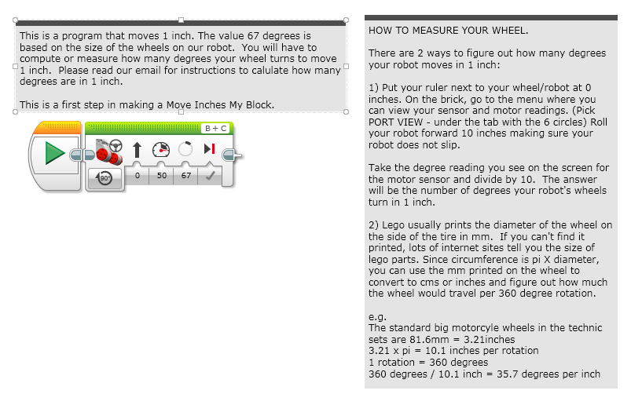
PHASE 1: MEASURE WHEELS

Slide 4
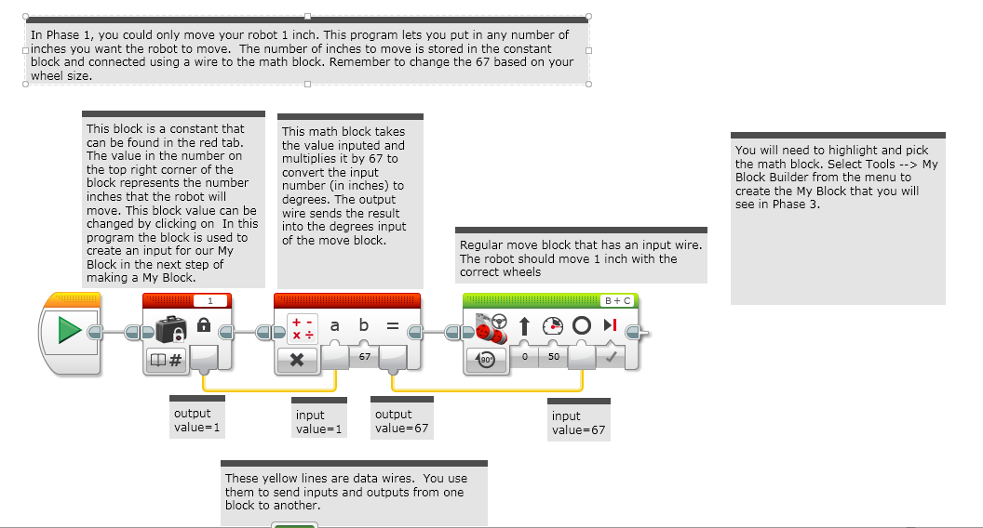
PHASE 2: Making aN INCHES TO DEGREES My Block

Slide 5
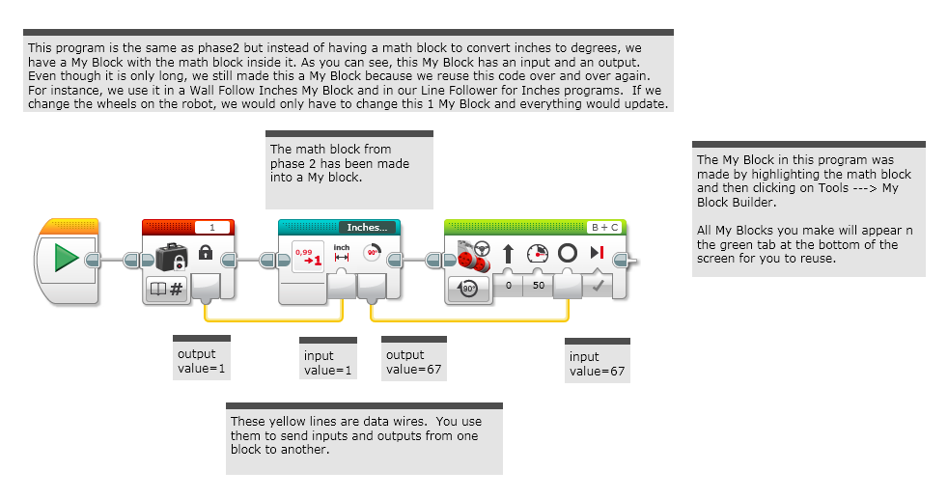
PHASE 3: Using the INCHES TO DEGREES MY BLOCK

Slide 6
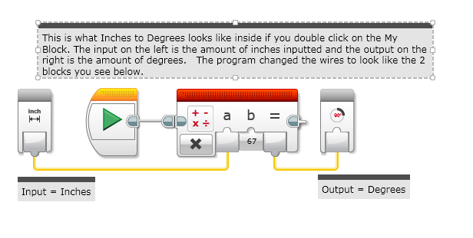
A LOOK INSIDE INCHES to DEGREES

Slide 7
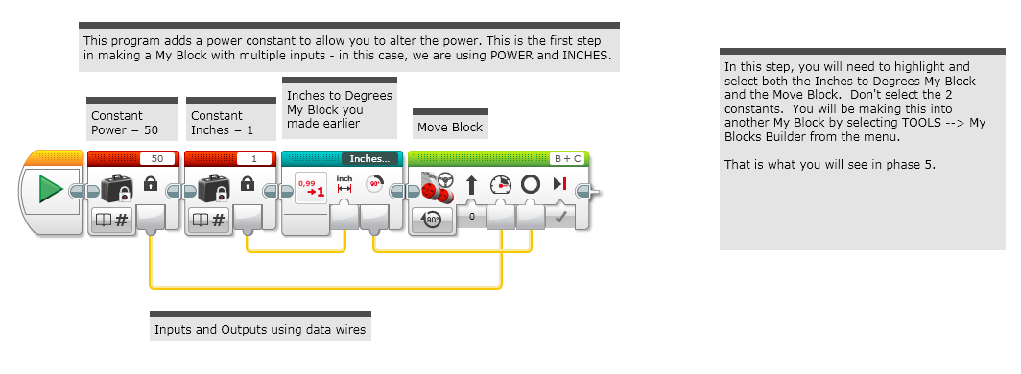
PHASE 4: ADDING INPUTS

Slide 8
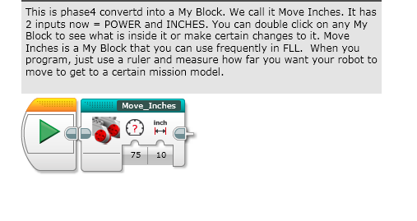
PHASE 5: COMPLETED Move InChes MY BLOCK

Slide 9
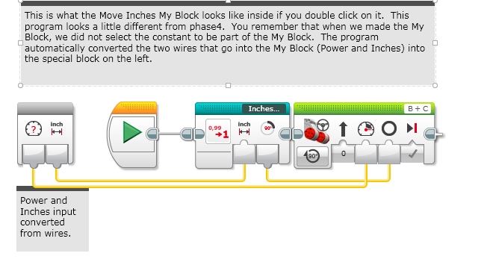
A LOOK INSIDE Move InChes

Slide 10
CREDITS
These slides and the corresponding EV3 project files were made by Sanjay Seshan and Arvind Seshan from FLL Team: Not the Droids You Are Looking For.
They are free to use and distribute. Please just give credit to the team and send a thank you note if you can.
You can reach the Droids at: team@droidsrobotics.org
Calculator for converting CM/IN into degrees: www.ev3lessons.com/resources.html
More lessons: www.ev3lessons.com

