Slide 1
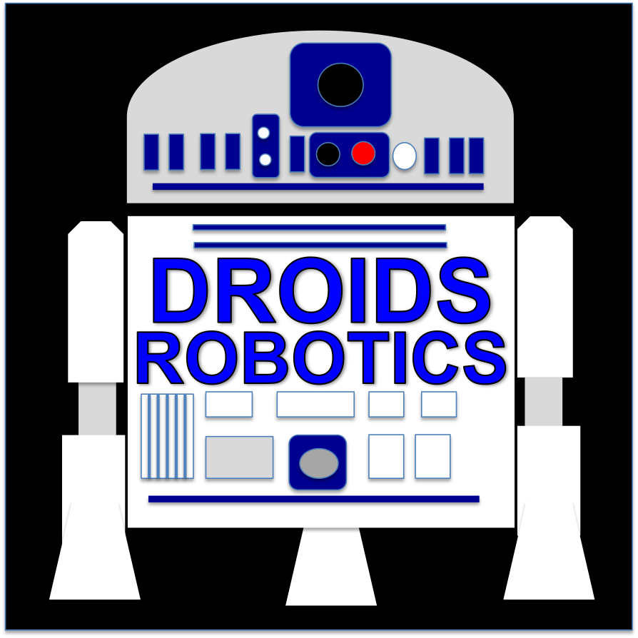
Advanced Ev3 programming LESSON Line Following: Basic to Proportional
By Droids Robotics
UPDATED 10/18/2014

Slide 2
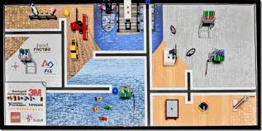
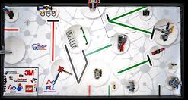
Line Following IS VALUABLE
Many FLL Mats are covered with lines
You can use these lines to navigate to mission models
Having a good line follower program can really help your team
We present 4 line followers in this lesson that would work for beginner through advanced teams.

Slide 3
WHICH PROGRAM WORKS BEST FOR WHICH LINE?
Simple Line Follower
Most basic line follower
Wiggles a lot due to sharp turns
Good for rookie teams → need to know loops and switches
Smooth Line Follower
Almost the same as simple
Turns are less sharp
Has trouble on sharp curves
Good for rookie teams → need to know loops and switches
3-Stage Follower
Best for straight lines
Droids do not recommend this. Just learn the proportional line follower.
Need to know nested switches
Proportional Follower
Uses the “P” in PID
Makes proportional turns
Works well on both straight and curved lines
Good for intermediate to advanced teams → need to know math blocks and data wires
Watch the videos on the next 2 slides to see the programs in action.

Slide 4
Curved Line: Watch Videos
Simple Line Follower
Smooth Line Follower
3-Stage Follower
Proportional Follower

Slide 5
Straight Line: Watch Videos
Simple Line Follower
Smooth Line Follower
3-Stage Follower
Proportional Follower

Slide 6
BEFORE YOU RUN THE CODE
CALIBRATE:
The programs use the EV3 Color Sensor in Light Sensor mode
You will have to calibrate your sensors.
Please refer to Calibration Lesson – Advanced Lesson #4
PORTS:
The Color Sensor is connected to Port 3.
Please change this for your robot.
WHICH SIDE OF THE LINE:
Please take note of which side of the line the code is written for

Slide 7
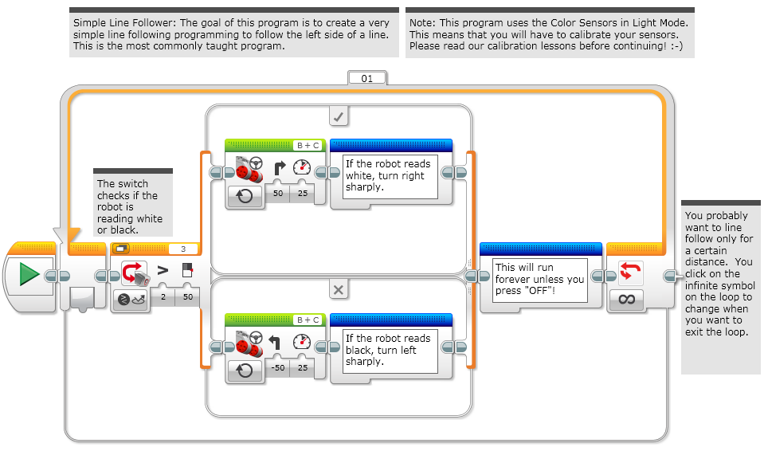
SIMPLE LINE FOLLOWER

Slide 8
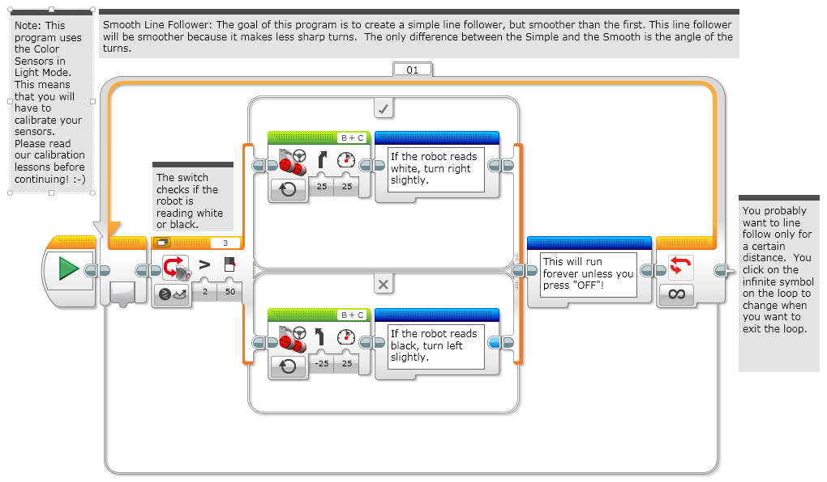
SMOOTH LINE FOLLOWER

Slide 9
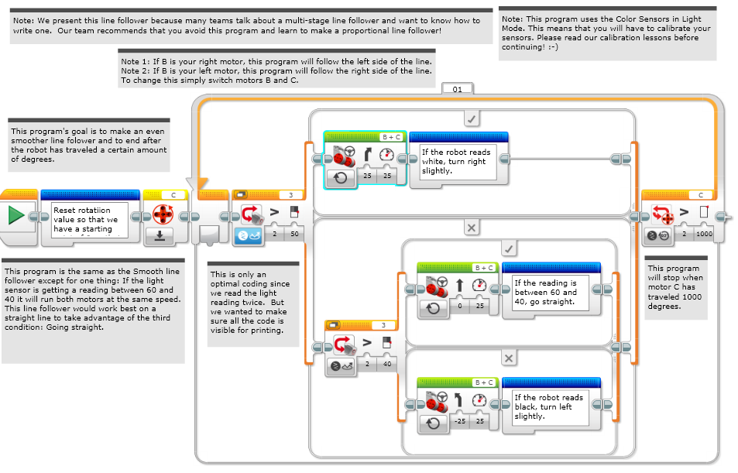
3-STAGE Line Follower

Slide 10
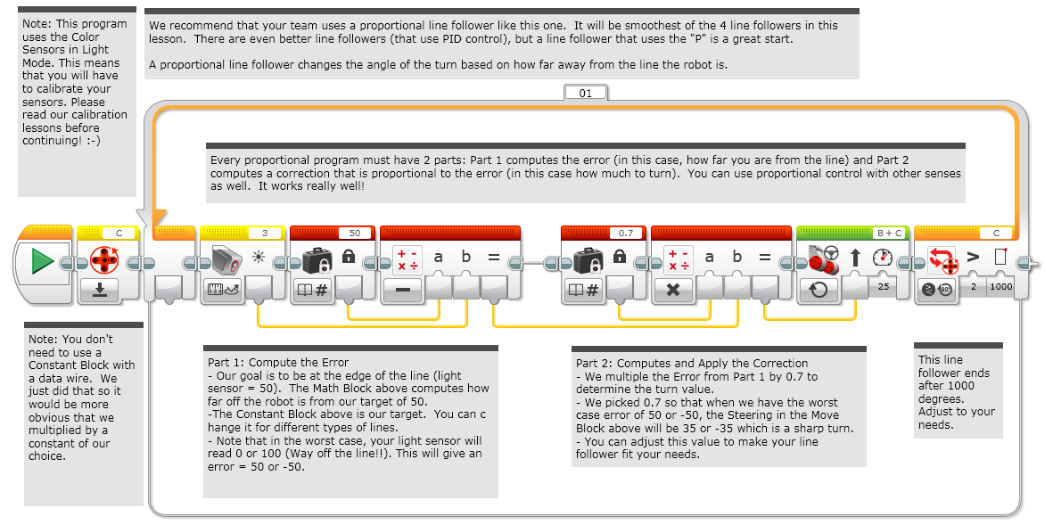
PROPORTIONAL LINE FOLLOWER
Updated: 10/17/2014. Code fixed to match comments. EV3 file updated.

Slide 11
TIPS
You will get better results
….if your color sensors are closer to the ground
….if you shield your color sensors
….remember to calibrate

Slide 12
CREDITS
These slides and the corresponding EV3 project files were made by Sanjay Seshan and Arvind Seshan from FLL Team: Not the Droids You Are Looking For.
They are free to use and distribute. Please just give credit to the team and send a thank you note if you can.
You can reach the Droids at: team@droidsrobotics.org
Calculator for converting CM/IN into degrees: www.ev3lessons.com/resources.html
More lessons: www.ev3lessons.com

